Slide 1
Hadoop MapReduce
A programming model and an associated implementation for processing
Notes:
This template can be used as a starter file for presenting training materials in a group setting.
Sections
Right-click on a slide to add sections. Sections can help to organize your slides or facilitate collaboration between multiple authors.
Notes
Use the Notes section for delivery notes or to provide additional details for the audience. View these notes in Presentation View during your presentation.
Keep in mind the font size (important for accessibility, visibility, videotaping, and online production)
Coordinated colors
Pay particular attention to the graphs, charts, and text boxes.
Consider that attendees will print in black and white or grayscale. Run a test print to make sure your colors work when printed in pure black and white and grayscale.
Graphics, tables, and graphs
Keep it simple: If possible, use consistent, non-distracting styles and colors.
Label all graphs and tables.

Slide 2
Agenda
Introduction
Inside MapReduce Flow
An Example
Advanced Topics
Notes:
This is another option for an Overview slide.

Slide 3
Introduction
Notes:
Use a section header for each of the topics, so there is a clear transition to the audience.

Slide 4
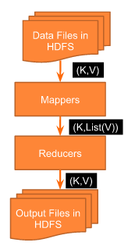
MapReduce Defined
Programming model and an associated implementation for processing and generating large datasets
Framework for parallel processing of huge datasets using a large no. of computers or nodes, collectively referred to as a cluster
Consists of two steps:
A map function that processes a key/value pair to generate a set of intermediate key/value pairs, and
A reduce function that merges all intermediate values associated with the same intermediate key.
Notes:
Add slides to each topic section as necessary, including slides with tables, graphs, and images.
See next section for sample table, graph, image, and video layouts.

Slide 5
Basic MapReduce Flow
A single file or multiple files is/are given as inputs to the map-reduce program
The file(s) is/are split into smaller parts called InputSplits
Each part is sent to a mapper
Mapper emits the intermediate output in the form of key-value pair
Shuffling and sorting is done in such a way that output with same key are grouped together
The output of the above step is sent to the reducer(s) for processing
Reducer emits the final output in the form of key-value pair
Notes:
Keep it brief. Make your text as brief as possible to maintain a larger font size.

Slide 6
Why this is useful?
Map-Reduce jobs are automatically parallelized
Partial failure of processing cluster is expected and perfectly tolerable
Redundancy and fault-tolerance are built-in; so the programmers need not worry
Scales up pretty well
Many real life jobs can be very well expressed in Map-Reduce paradigm as well
Paradigm shift – program moves as close as possible to data to make processing faster
Well defined framework makes development easy and less time consuming

Slide 7
MapReduce Algorithms
Algorithms need to be able to execute independently on different pieces of data
2 data pieces should not have interdependencies
In case of dependencies, Map-Reduce out of the box is difficult to fit
Making conventional algorithms to work in distributed computing requires considerable effort and is itself a field of study
Some solutions are a direct fit for distributed while others may not fit at all
Complexity in processing for data transformation is usually culmination of Map and Reduce algorithms put together
Notes:
If there is relevant video content, such as a case study video, demo of a product, or other training materials, include it in the presentation as well.

Slide 8
Some Common Uses
Machine Learning Algorithms e.g. Mahout
Sorting huge data
Counting
Data Extraction and Transformation
Data Analysis
Text Analysis
Genomic Analysis
Advertising Analysis
Social Network Analysis
Scientific Analysis of Cosmic Data
Financial Analysis
…and many more
Notes:
Add a case study or class simulation to encourage discussion and apply lessons.

Slide 9
Inside MapReduce Flow
Notes:
Use a section header for each of the topics, so there is a clear transition to the audience.

Slide 10
Execution Overview - Map
A map-reduce job is submitted. One of the machines becomes the master
Partition the input into M splits (>= 64 MB each usually) and distribute among the machines
A worker reads its split and begins work
Upon completion the worker notifies the master
The master partitions the intermediate keyspace into R pieces with a partitioning function
Notes:
Discuss outcomes of the case study or class simulation.
Cover best practices.

Slide 11
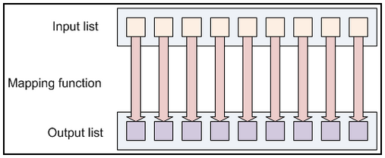
Execution Overview - Map
Notes:
Discuss outcomes of the case study or class simulation.
Cover best practices.

Slide 12
Execution Overview - Reduce
When a reduce worker is notified about a job, it uses RPC to read the intermediate data from the Mapper and then sorts it by key
The Reducer processes its job and then writes its output to the final output file for its reduce partition
When all reducers are finished, the master wakes up the user program
Notes:
Discuss outcomes of the case study or class simulation.
Cover best practices.

Slide 13
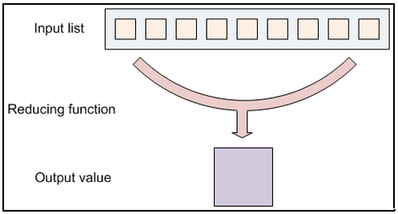
Execution Overview - Reduce
Notes:
Discuss outcomes of the case study or class simulation.
Cover best practices.

Slide 14
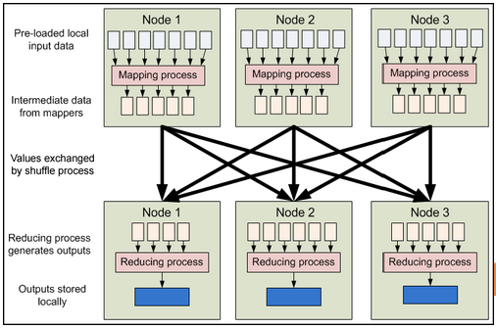
MapReduce Data Flow
Notes:
Discuss outcomes of the case study or class simulation.
Cover best practices.

Slide 15
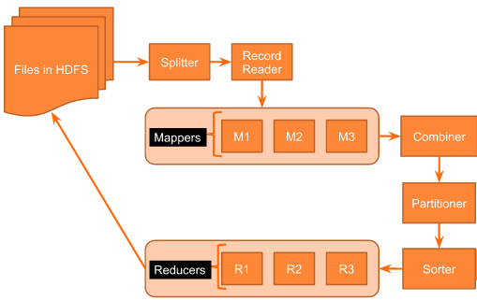
MapReduce Detailed Flow
Notes:
Discuss outcomes of the case study or class simulation.
Cover best practices.

Slide 16
An Example
Notes:
Use a section header for each of the topics, so there is a clear transition to the audience.

Slide 17
Word Count Problem and Solution
Problem Statement
There is a huge file. Determine count of each word in the file
Solution Approach
MapReduce take advantage of the huge no. of nodes in the cluster
MapReduce runs in parallel at each node in the cluster
Implementation
Mapper will read each line of the file, and emit 1 as value for each word which will constitute the key
Reducer will group intermediate keys generated by the mappers and sum up the values for each key to come up with the count for each word
Notes:
Discuss outcomes of the case study or class simulation.
Cover best practices.

Slide 18
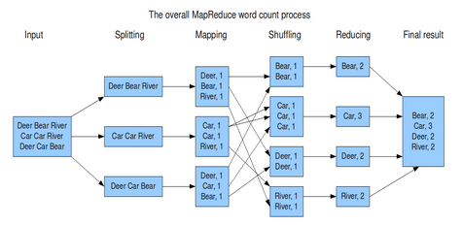
Word Count using MapReduce
Notes:
Discuss outcomes of the case study or class simulation.
Cover best practices.

Slide 19
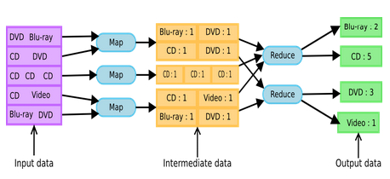
Another Word Count Example
Notes:
Discuss outcomes of the case study or class simulation.
Cover best practices.

Slide 20
Word Count Data Flow
File is taken as input to the word count program
File is split into lines, each line is given a unique number (byte offset)
Mapper receives one line at a time in the form of key-value pair
Key: Byte Offset of line
Value: The line
Mapper splits the line into words and for each word it emits the output in the form of key-value pair
Key: Word
Value: 1 (count of one word)
Notes:
Discuss outcomes of the case study or class simulation.
Cover best practices.

Slide 21
Word Count Data Flow….contd.
Once all the words are emitted, shuffling takes place
Shuffling groups the keys together
Reducer is fed with key along with a list of all the values associated with that key
Key: Word
Value: List of counts
Reducer performs sum of counts in the list and emits the output
Key: Word
Value: Total count of word in file
Notes:
Discuss outcomes of the case study or class simulation.
Cover best practices.

Slide 22
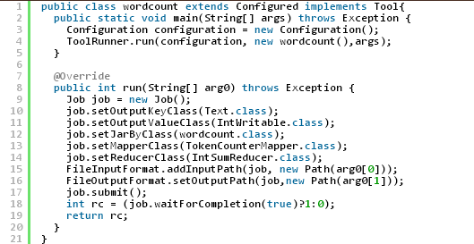
Word Count – OOB Implementation
Use Hadoop’s TokenCounterMapper.class as the Mapper which tokenizes the input text and emits each word with count 1
Use Hadoop’s IntSumReducer.class as the Reducer which sums the values in the Input list of the reducer and outputs to context
Driver class listing:
Notes:
Discuss outcomes of the case study or class simulation.
Cover best practices.

Slide 23
Word Count – Mapper
Mapper Class WCMap extends Class Mapper<LongWritable, Text, Text, IntWritable>
First generic parameter is the Byte Offset
Second Generic parameter Text represents each line fed to the Mapper one at a time
Third Generic parameter is again a Text which represents the Key emitted from the Mapper
Fourth Generic parameter IntWritable is the type of value the Mapper emits against each Key
Override the Map method of the Mapper class to parse the input line and ouput the splitted words with count 1 to the Context
Notes:
Discuss outcomes of the case study or class simulation.
Cover best practices.

Slide 24
Word Count – Mapper code
public class WCMap extends Mapper<LongWritable, Text, Text, IntWritable>
{
public void map(LongWritable key, Text value,Context context) throws java.io.IOException ,InterruptedException
{
String line = value.toString();
String [] tokens = line.split(" "); // This is the delimiter between words
for (String tok :tokens)
{
context.write(new Text(tok), new IntWritable(1));
}
}
}
Notes:
Discuss outcomes of the case study or class simulation.
Cover best practices.

Slide 25
Word Count – Reducer
Reducer Class WCReduce extends Class Reducer<Text, IntWritable, Text, IntWritable>
First generic parameter is the Input Key type from Mapper
Second Generic parameter represents Input Value Type List from Mapper
Third Generic parameter is a Text which represents the Key emitted from the Reducer
Fourth Generic parameter IntWritable is the type of value the Recuer emits against each Key
Override the Reduce method of the Reducer class to sum up the counts for all values in the list for the same key and output the final count
Notes:
Discuss outcomes of the case study or class simulation.
Cover best practices.

Slide 26
Word Count – Reducer code
public class WCReduce extends Reducer<Text, IntWritable, Text, IntWritable>
{
public void reduce(Text key, Iterable list ,Context context) throws java.io.IOException ,InterruptedException
{
int count = 0;
for (IntWritable item : list)
{
count += item.get();
}
context.write(key, new IntWritable(count));
}
}
Notes:
Discuss outcomes of the case study or class simulation.
Cover best practices.

Slide 27
Word Count – Driver code
public class wordcount extends Configured implements Tool{
public static void main(String[] args) throws Exception {
// TODO Auto-generated method stub
Configuration configuration = new Configuration();
ToolRunner.run(configuration, new wordcount(),args);
}
@Override
public int run(String[] arg0) throws Exception {
Job job = new Job();
job.setOutputKeyClass(Text.class);
job.setOutputValueClass(IntWritable.class);
job.setJarByClass(wordcount.class);
job.setMapperClass(WCMap.class);
job.setReducerClass(WCReduce.class);
FileInputFormat.addInputPath(job, new Path(arg0[0]));
FileOutputFormat.setOutputPath(job,new Path(arg0[1]));
job.submit();
int rc = (job.waitForCompletion(true)?1:0);
return rc;
}
}
Notes:
Discuss outcomes of the case study or class simulation.
Cover best practices.

Slide 28
Input And Output – Key / Value
Utilizes Hadoop’s serialization mechanism to write data in and out of network, database or files
Optimized for network serialization
A set of basic types are provided
Easy to implement your own
Extends Writable Interface
For Serialization mechanisms
Defines how to read and write fields
Bundled in org.apache.hadoop.io package
Keys must implement WritableComparable Interface
Extends Writable and Comparable
Required because keys are sorted prior to Reduce phase
Hadoop is shipped with many default implementations of WritableComparable
Wrappers for primitives (String, Integer etc.)
Possible to implement your own
Notes:
Discuss outcomes of the case study or class simulation.
Cover best practices.

Slide 29
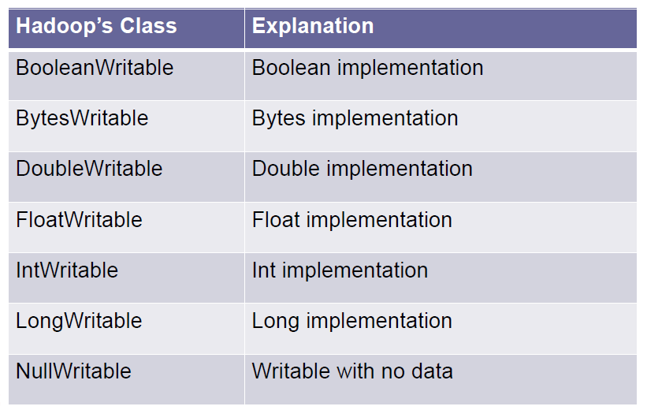
Inbuilt Types
Notes:
Discuss outcomes of the case study or class simulation.
Cover best practices.

Slide 30
Input Splits
Splits are a set of logically arranged records
A set of lines in a file
A set of rows in a Database table
Each instance of Mapper will process a single split
Map instance processes one record at a time
map(key, value) is called for each record
Splits are implemented by extending InputSplit class
Framework provides many options for InputSplit implementations
Hadoop’s FileSplit
HBase’s TableSplit
Don’t really need to deal with Splits directly
It’s InputFormat’s responsibility
Notes:
Discuss outcomes of the case study or class simulation.
Cover best practices.

Slide 31
InputFormat
Specification for reading data
Creates InputSplits
Breaks up work into chunks
Specifies how to read each split
Divides splits into records
Provides an implementation of RecordReader
Usage of InputFormat
Calculate Splits by calling InputFormat.getSplits()
For each split schedule a map task
Distributed on the cluster
Each Map executes in its own JVM
For each Mapper instance a RecordReader is retrieved by invoking InputFormat.createRecordReader()
Takes InputSplit instance as a parameter
RecordReader generates key-value pairs
map() method is called for each key-value pair
Notes:
Discuss outcomes of the case study or class simulation.
Cover best practices.

Slide 32
Inbuilt Input Formats
Packaged with many InputFormat Implementations
TextInputFormat
NLineInputFormat
DBInputFormat
TableInputFormat
StreamInputFormat
SequenceFileInputFormat
And many more…
Configure on a Job object
job.setInputFormatClass(XXXInputFormat.class)
Notes:
Discuss outcomes of the case study or class simulation.
Cover best practices.

Slide 33
Combiner
Runs on output of Map function
Produces input for Reduce function
Optimization to reduce bandwidth
NO guarantees on being called
Maybe only applied to a subset of map outputs
Often is the same class as the Reducer
Each combine processes output from a single Split
To implement Combiner extend the Reducer class
Set Combiner on Job object
job.setCombinerClass(WordCountReducer.class)
Notes:
Discuss outcomes of the case study or class simulation.
Cover best practices.

Slide 34
Output Format
Specification for writing data
The other side of InputFormat
Implementation of OutputFormat
TextOutputFormat is the default implementation
Outputs records as lines of text
Key and values are tab separated
Can be configured via mapreduce.output.textoutputformat.separator property
Key and value may be of any type – call .toString()
Validates output specification for the job
Error message if output directory already exists on HDFS
Creates implementation of RecordWriter
Responsible for actually writing data
Creates implementation of OutputCommitter
Setup and cleanup jobs’ and tasks’ artifacts (e.g. directories)
Commit or discard tasks’ output
Notes:
Discuss outcomes of the case study or class simulation.
Cover best practices.

Slide 35
Inbuilt Output Formats
Hadoop is packaged with many OutputFormat implementations
TextOutputFormat
DBOutputFormat
TableOutputFormat
MapFileOutputFormat
SequenceFileOutputFormat
NullOutputFormat
And many more…
Configure on Job object
job.setOutputFormatClass(XXXOutputFormat.class)
job.setOutputKeyClass(XXXKey.class)
job.setOutputValueClass(XXXValue.class)
Notes:
Discuss outcomes of the case study or class simulation.
Cover best practices.

Slide 36
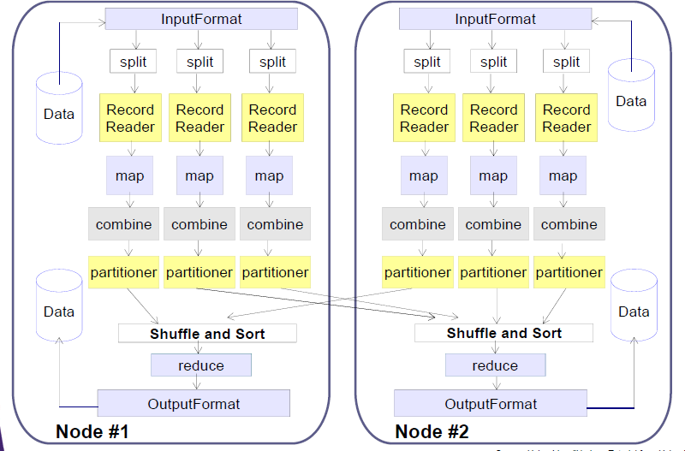
Component Overview
Notes:
Discuss outcomes of the case study or class simulation.
Cover best practices.

Slide 37
Counters
Instrument Job’s Metrics
Gather Statistics
Quality Control – confirm what was expected
Diagnostics
Set of built-in metrics
For example, bytes processed for input and output
User can create new counters
Number of records consumed
Number of errors and warnings
Counters are divided into groups
Tracks Total, mapper and reducer counts
Several groups of built-in counters
Job counters: documents no. of map and reduce tasks launched, no. of failed tasks
File System counters: no. of bytes read and written
MapReduce framework: mapper, reducer, combiner input and output records, time and memory statistics
Notes:
Discuss outcomes of the case study or class simulation.
Cover best practices.

Slide 38
Execution
Open Eclipse in Cloudera
Create a new Java Project
Create the mapper reducer and Driver classes
Driver Class: A separate Java class part of Map Reduce program inside which Map Reduce job configuration is defined.
Add the jar files to the project as shown in next slide
If you have developed code on Eclipse inside Cloudera:
Right click on Project Folder
Select Run As
Select Java Application – the Map-Reduce job gets executed.

Slide 39
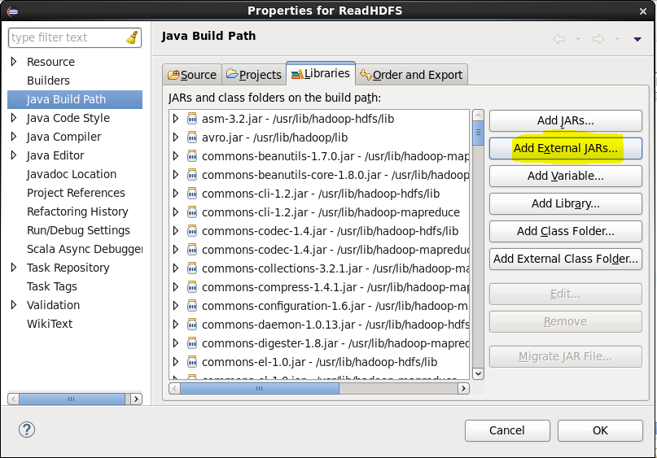
Adding Jar files To add jar files to project please find the highlighted flow from screen shots starting form this slide

Slide 40
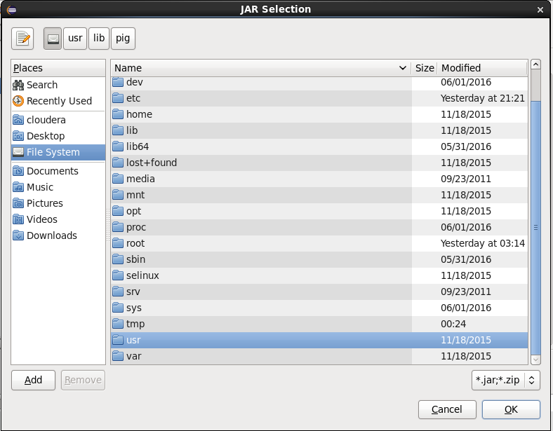
Navigation to the folders select usr folder

Slide 41
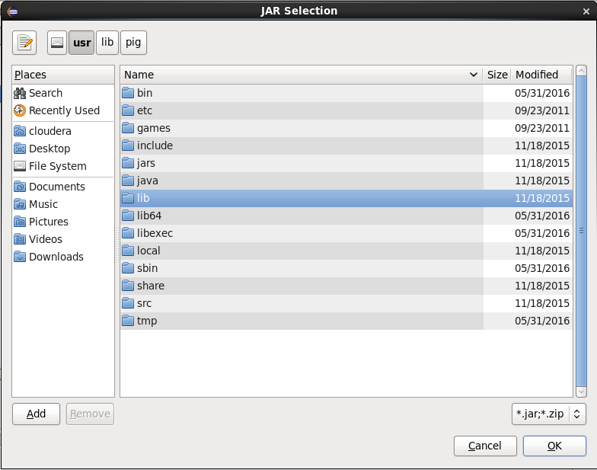
Navigation to the folders select lib folder

Slide 42
Selecting the jar files
While writing some code to interact with specific component
Ex. If we are writing some code to interact with Hive component select hive folder from the list shown in next slide, select all the .jar files inside this folder. But do not add any folders.
Ex. If we are writing some code to interact with HBase component select hbase folder from the list shown in next slide.s
As YARN and Zokeeper takes care of scheduling and resource allocation for jobs, by default we need to add the yarn and Zookeeper related jar files by selecting Hadoop-yarn and zookeeper folders from the next slide.
The jar files are available under usr/lib/ folder for all the components.

Slide 43
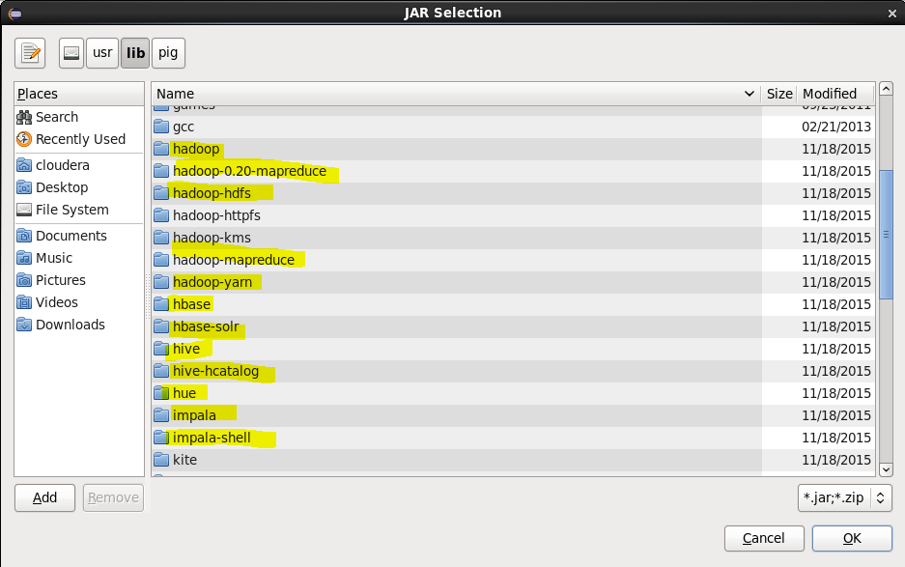
Navigation to the folders select jar files from the below folders as required, as explained in previous slide.

Slide 44
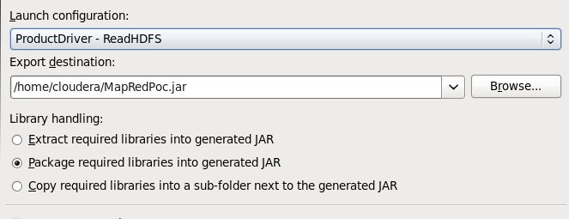
Jar Configuration
If we are developing code on Eclipse outside Cloudera(cluster):
Right click on Project Folder
Select Export
Expand Java -> select Runnable Jar file
Click Next

Slide 45
Jar Configuration
In the previous slide
Launch Configuration: Select the Driver class from the Project Folder we are creating (All driver classes will be shown in DropDown).
Select the Export directory, means the local file system path to store the load file.
under Library Handling:
Select the “Extract required libraries into generated JAR” option and click on Finish.
Jar file will be generated and exported to the mentioned directory, will give completion popup message.

Slide 46
Running the Jar
Open a new terminal on Cloudera(cluster)
Move the jar file from Windows to Local FS.
On the command prompt:
Use the following command:
hadoop jar MapRedPoc.jar ProductDiver
The same command can be used to execute the code on the multi-node cluster also.
The Job will start running

Slide 47
Questions?

